Slide 1



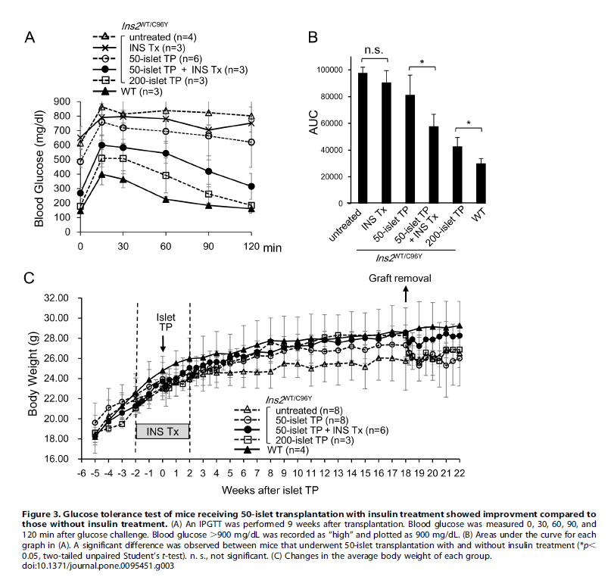
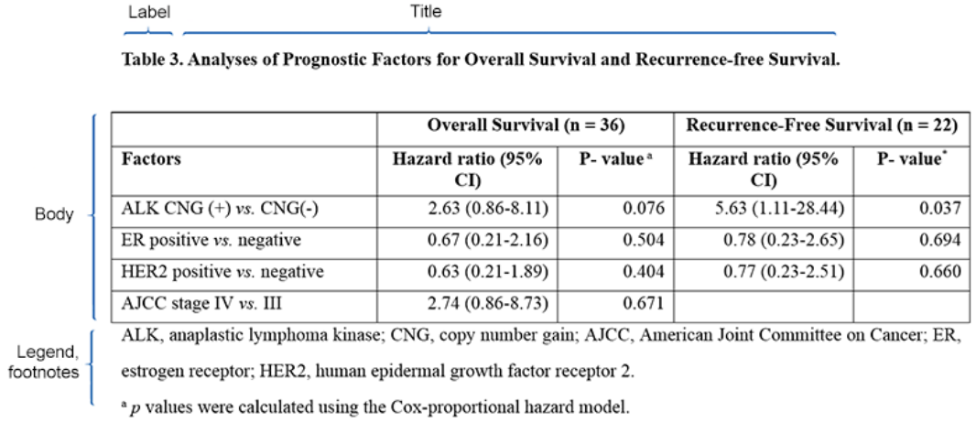
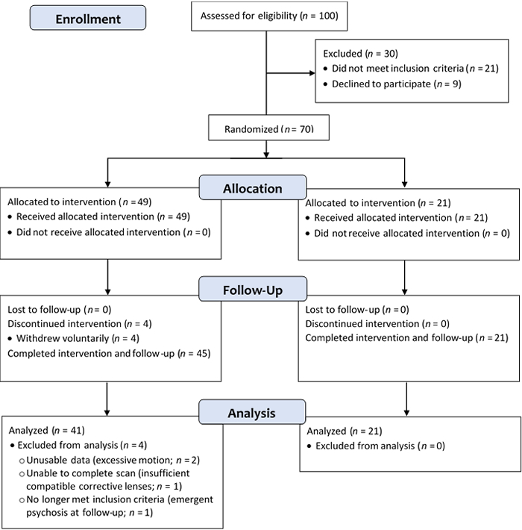
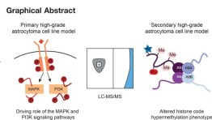
ICOGE 2026
4th International Conference on Global Education:
ICOGE 2026
Transforming Education in the Age of Artificial Intelligence.
TITLE
Title should be short and draws interest
INTRODUCTION
Text is clear and to the point (minimum font size 20)
Use of bullets, numbering, and headlines make it easy to read.
Effective use of graphics, colour and fonts
Consistent and clean layout
This section should be written to target intelligent individuals who is not in your field. Assume they don’t know your study . Quickly (first sentence or two) get your viewer interested in the issue or question that drove you to take up the project. Use the absolute minimum of background information, definitions, and acronyms (all of which may be boring). Place your issue in the context of published, primary literature. Pitch an interesting, novel hypothesis, then describe (briefly) the experimental approach that can test your hypothesis.
*Note: Authors have the freedom to change the poster layout and content.
METHODOLOGY
FINDINGS/RESULTS
This section should briefly describe experimental equipment and procedure, but not with the detail used for a manuscript. Use figures or flow charts to illustrate experimental design if possible. Include a photograph or labelled drawing or setup. Mention statistical analyses that were used and how they allowed you to address hypothesis.
Examples of methodology flow chart
First, mention whether your experiment procedure actually worked. In same paragraph, briefly describe qualitative and descriptive results to give a more personal tone to your poster.
In second paragraph, begin presentation of data analysis that more specifically addresses your hypothesis. Refer to supporting charts or images.
Provide engaging figure legends that could stand on their own (i.e., could convey some point to reader if viewer skipped all other sections, which they will do). Opt for figures over tables whenever possible.
          Example of Figure Example of Table
Adapted from https://mvmlearning.files.wordpress.com/2014/06/image3.png
Adapted from: Kim MH, Lee S, Koo JS, Jung KH, Park IH, et al. Anaplastic lymphoma kinase gene copy number gain in inflammatory breast cancer (IBC): prevalence, clinicopathologic features and prognostic implication. PLoS ONE. 2015. 10(3): e0120320. doi:10.1371/journal.pone.0120320
DISCUSSION
This section should state the importance of the research that is presented in the poster. It should provide an interpretation of the results, especially in context to previously published research. It may propose future experiments that need to be conducted as a result of the research presented in the poster. It should clearly illustrate the significance of the research with regards to new knowledge, understanding and/or discoveries that were made as part of the research.
Example of graphical image
https://apastyle.apa.org/style-grammar-guidelines/tables-figures/sample-figures
https://www.mcponline.org/article/S1535-9476%2820%2932213-1/fulltext
CONCLUSION
DISCUSSION
This section should remind the reader, without sounding like you are reminding the reader, of the major result and quickly state whether your hypothesis was supported. Try to convince the reader why the outcome is interesting (assume they’ve skipped the Introduction). State the relevance of your findings to other published work. Add relevance in the real world. Add sentence on future directions of research.
This section should follow any general citation format (APA, Vancouver, MLA, Harvard, Chicago, etc.)
ACKNOWLEDGEMENT:
Thank individuals for specific contributions (equipment donation, statistical advice, laboratory assistance, comments on earlier versions of the poster). Mention who has provided funding. Also include in this section disclosures for any conflicts of interest and conflicts of commitment.
Author(s) name and institution affiliation
(Could also add pictures of author(s))
Author(s) name and institution affiliation
(Could also add pictures of author(s))

