Slide 1
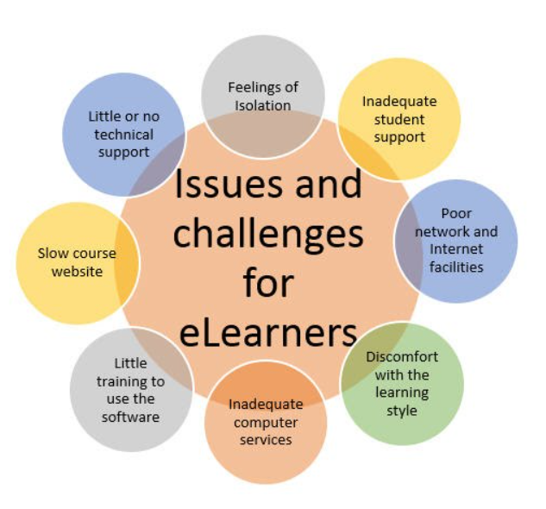
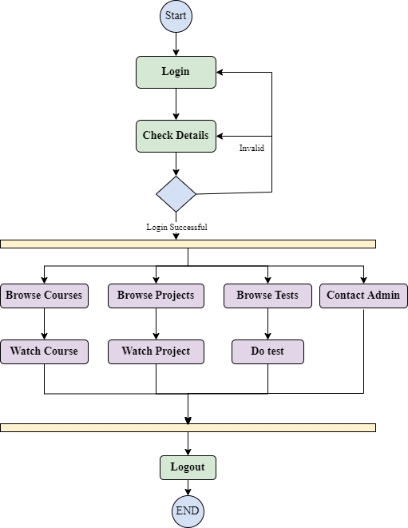
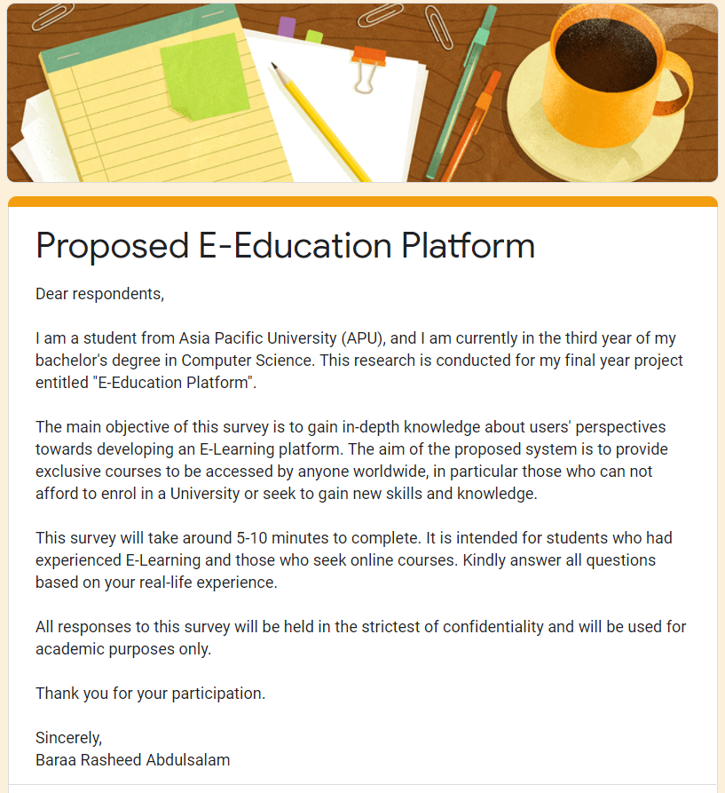
ICOGE 2025
3rd International Conference on Global Education:
Empowering Learners for the Digital Era
E-education: Enhancing Access to Learning Opportunities Through an Interactive
Online Platform
INTRODUCTION
Much of what is accomplished nowadays has been made possible by education.
Only 6.7 percent of the world's population holding a bachelor's degree, one of the most common obstacle is the lack of financial means (Abuhassna, 2020).
Available E-learning systems have restrictions that limit the usefulness of E-Learning Mahyoob, 2020).
This project aims to create an user friendly E-learning platform called E-Education.
METHODOLOGY
RESULTS
Quantitative approach : A survey was used to collect data from a total of 120 target users (UG Students) to help in understanding the features to consider for achieving the projects' aim which is implementing a user-friendly system and adding most-requested courses.
DISCUSSION
By analysing the data collected from 120 UG Students; the important characteristics and functions of the proposed E-education platform were comprehended.
The platform was developed with a useful system architectural style and usable capabilities enabling it to be simple and convenient to use while meeting the requirements of students who would utilise it. The activity diagram above illustrates the dynamic parts of the system.
CONCLUSION
REFERENCES
The research conducted was beneficial, as it generated a great deal of useful data through various tasks. The project was developed effectively with a high-quality web-application. Nevertheless, some areas are still needed to be investigated and developed further in the future.
Abuhassna, H. (2020). Examining Students’ Satisfaction and Learning Autonomy through Web-Based Courses. International Journal of Advanced Trends in Computer Science and Engineering, 9(1), 356–370. https://doi.org/10.30534/ijatcse/2020/53912020
Mahyoob, M. (2020). Challenges of e-Learning during the COVID-19 Pandemic Experienced by EFL Learners. Arab World English Journal, 11(4), 351–362. https://doi.org/10.24093/awej/vol11no4.23
ACKNOWLEDGEMENT:
Thank you to everybody who has helped me through the completion of my Investigation Report.
I am grateful for their enthusiastic instruction, suggestions for improvement, and helpful advises
Baraa Rasheed Abdulsalam
Faculty of Computer Science, Asia Pacific University (APU), Malaysia

